Slide 1

Anaheim Regional Transportation Intermodal Center Project Update

Slide 2
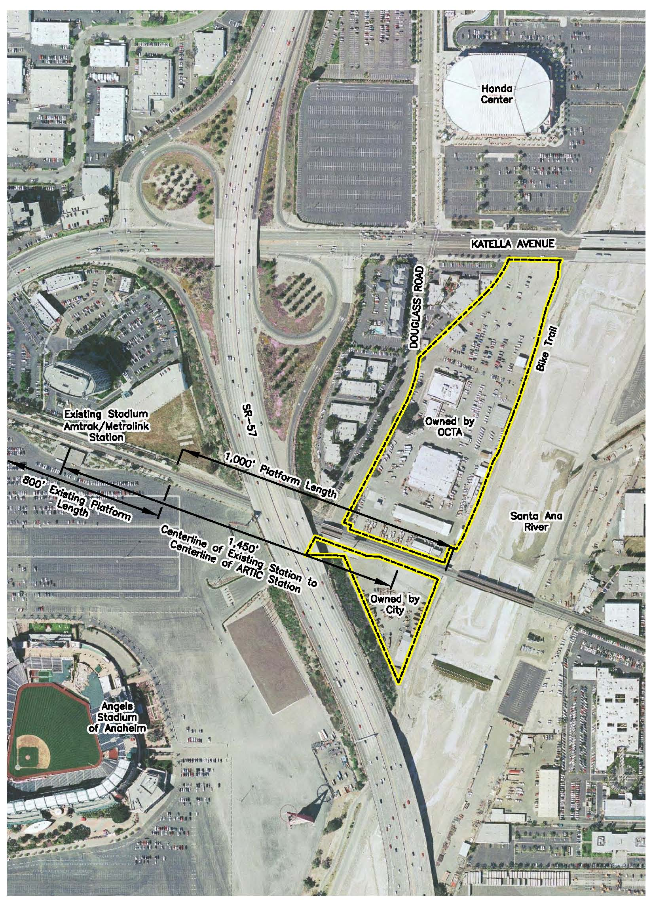
Project Location
OCTA purchased 13.5 acres
of land in 2006
Land is adjacent to the
Los Angeles – San Diego –
San Luis Obispo (LOSSAN)
rail corridor and the
City of Anaheim’s (City)
2.2 acres
Current station is not
easily accessible from
Katella Avenue and is
constrained by event traffic

Slide 3
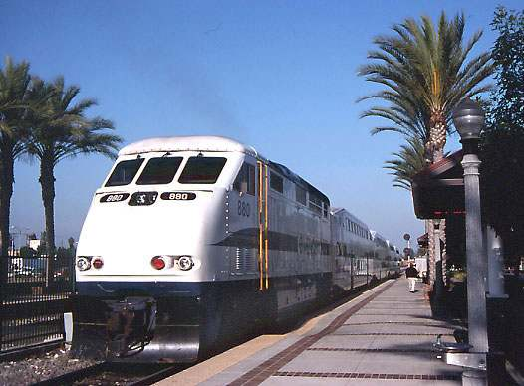
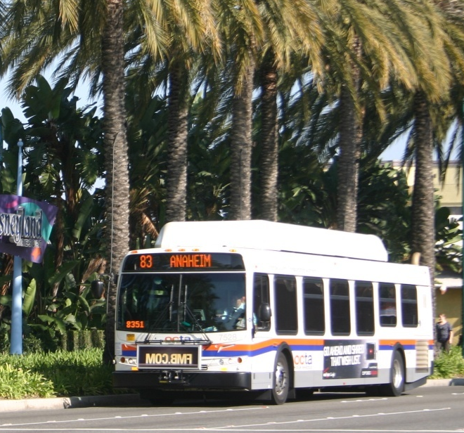
Project Overview
  Designed to accommodate current transit services, growth and future transportation modes:
    Metrolink
    Amtrak
    OCTA Buses
    Anaheim Resort Transit
    Los Angeles World Airport Flyaway Shuttles
    Taxi Services
    Intercity Buses
    International Buses
    Tour and Charter Buses
    Private Vehicles/Parking
  Future Services:
    Metrolink Service Expansion Program
    Anaheim Rapid Connection
    California High-Speed Rail (HSR)
Notes:
See list of services on slide

Slide 4
Project Background – Significant Board Actions
OCTA Board Approved | Roles and Responsibilities
November 2005 | OCTA entered into a memorandum of understanding with the City for joint development of the Anaheim Regional Transportation Intermodal Center (ARTIC)
November 2006 | OCTA purchased 13.5 acres of land from the Orange County Flood Control District for development of ARTIC (adjacent to the LOSSAN rail corridor and City’s 2.2 acres)
May 2007 | Board of Directors (Board) approved ARTIC project concept, which included a three-phase 20-year development approach
December 2007 | Board approved to fund early project development activities
May 2009 | City competes for Measure M2 Project T Program funds and is awarded $178.8 million for design and construction of ARTIC Phase 1
May 2009 | City procured and awarded architectural and engineering design contract to Parsons Brinckerhoff/HOK and subsequently awarded contracts to Anaheim Gateway Partners
Notes:
The need for ARTIC is clear: with population in Orange County projected to increase by 29% between 2000 and 2040, traffic and mobility continue to be critical issues to our future.
Anaheim is currently California’s 10th largest city with nearly 350,000 residents and attracts over 20 million visitors a year.
In addition, the City is known for its major sports and entertainment venues that have the potential to generate an additional 250,000 people per year.
Demand and interest for rail continues to grow with both Metrolink and Amtrak working on rail expansion programs.
Anaheim’s central location within Orange County, makes it an ideal hub where freeways, major arterials, bus routes and Orange County’s backbone rail transit system converge.

Slide 5
Environmental and Design Status
  May 2009 – Architectural and design firm procured
November 2010 – City Council certified environmental
impact report
February 2011 – National Environmental Policy Act environmental clearance
Significant Progress on Design
City has worked concurrently with all transportation providers including Amtrak, California HSR, Metrolink, and OCTA to ensure provider needs are met at facility

Slide 6
HSR Integration
ARTIC designed to have independent utility as an
intermodal transit hub to serve current demand while
also serving future growth
  ARTIC will be ready to implement and integrate with HSR
  Close coordination to ensure design elements implemented in the short term for ARTIC will not need to be removed to accommodate HSR

Slide 7
ARTIC Funding
Fully funded with combination of local, state, and federal sources
Funding Source | Amount (in millions)
Measure M2 Project T Bond Proceeds | $99.2
Measure M Transit Revenue | $ 44.6
2008 State Transportation Improvement Program | $ 29.2
Federal Earmark | $ 3.2
Federal Transit Administration | $ 7.6
Total | $183.8
Elements Include:
  Terminal building
  Track/platform
  Railroad bridge
  Bus facilities
  Roadway improvements
  Parking

Slide 8
Next Steps
City to continue with the Request for Qualifications to secure a contractor for the terminal shell and enclosure
OCTA and City to execute a long-term lease agreement with the City of land owned by OCTA
City to finalize the environmental clearance

